Slide 1

Agile Enablement
IBM Point of View
October 4, 2012

Slide 2
Agenda
Agile Business Case and Transformation
IBM’s “Agile With Discipline” Methodology
Agile Processes and Teams
Agile Coaching
Agile Testing
Throughput Based Agile Estimation and Sourcing
Agile Implementation Experiences
Notes:
IBM Confidential

Slide 3
Agile can be applied to any solution delivery effort, but is most suitable for addressing these challenges and work types
Key Challenges
Work types most aligned with agile
Mobile application development
Interactive high-end internet websites
Projects with a grand vision, needing elaboration with stakeholders as it is built
Requirements are dynamic and difficult to lock down
High ROI for early realization of some of the scope
eCommerce
Business needs flexibility to adapt to changing market needs
Deliver business value more quickly
Proofs of concepts
Small pieces of large, complex, architectures
Reduce risk of adopting new technologies

Slide 4
This example shows one extreme case of business value realization and lost opportunity that agile would have enabled *
Scenario
Agile is used with high quality, higher rate, onsite, resources teamed with the client business and select IT resources
Agile techniques were not integrated and typical requirements and lifecycle delays occurred
We would have removed traditional delays, prioritized and delivered requirements, and cut two months from the first release
Actual Project
Cost
Variable scoping assures delivering to baseline
$7 Million
  $5 Million baseline
  plus
  $2 Million through scope changes
$5 Million assumed (deliver essential scope earlier)
Business Value
After Launch
Tangible, measurable business benefits of thousands of dollars per day or more
$1 Million per day in revenue, two months late
$1 Million per day in revenue, for 60 extra days, reported a quarter earlier
ROI
Solution pays for itself in shorter term, and can make rate per hour comparisons irrelevant
Solution paid for itself in 7 days
Solution would have generated an additional $60 Million dollars, one quarter earlier, and paid for itself in 5 days
Achievable value
Waterfall
Actual Results
If Agile had been used *
Value driven by Agile:
$2 Million
+
$60 Million
=
$62 Million
* This is a real project example where IBM and our client implemented a high revenue generating internet application using traditional methods, and at post-implementation determined that the initiative could have been delivered two months earlier by using an Agile delivery approach

Slide 5
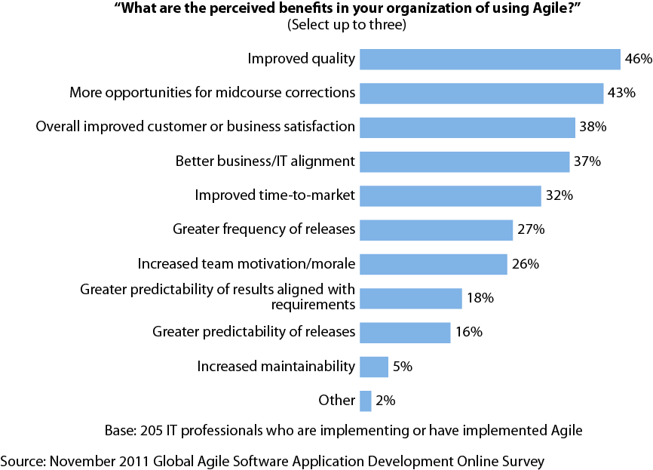

Forrester research supports IBM’s external and internal findings that agile provides improved quality, flexibility and speed to value
January 2012 “Navigate The Future Of Agile And Lean”

Slide 6
Agile adoption represents an organizational transformation
Present
Transformation
Future
Integrated BT & Business Transformation PMO
Project Based Enhancement and New Development Capability Center
Business Program Manager
BT Program Manager
Transformation Planning & Guidance
Funding / Budget / Control
Project C
Reporting
Project B
Guidance
Project C
Project A
Project B
Project
Manger
Pilot Agile/Iterative/Accelerated
Projects
Business
Enablement
Focused
Project A
Teamrooms
Dedicated Resources
Heavy Business participation
Dedicated Core Team
Infuse select SMEs
for Projects
Delivery/Maint/Ops
HR Transformation
Application Maintenance and Operations Center
BA Definition/Staffing
Project / Sustain Orgs
Competency COEs
Career Paths
Application 1
Management Practices
System Portfolio Z
Effort (hours) recording
Metrics based management
Investment analysis/resource redeployment
System Portfolio Y
Delivery Resources
System Portfolio X
Application 2
Application Portfolio Transformation
Analyze current application portfolio
Consolidation of redundant apps
Reduce app groups and management
Cost
And
SLA
Focused
App Maintenance/Ops
Cost Reduction
Opportunity Study
App 1
Application 3
App 2
App 1
Outsourcing
Global Support
App 3
App 2
App 1
App 3
BT & Business Collaboration
App 2
Improved Requirements/BPS
More explicit collaboration
Active Business participation in Projects
App 3

Slide 7
Transformation in a large enterprise is not easy
Agile Enablers
Need for Change - Stakeholders must be recognized and believe in the need for change. A sense of urgency must exist.
Vision - The new agile approach/model and its value (benefits vs. costs) must be clearly understood (how does it address the need for change?)
Personalize - Each person needs to clearly understand the impact on them
Participation and ownership - Each person needs to be confident their input will be recognized, valued, and respected. Can’t be allowed to stand on the sidelines.
Lead – Those impacted by the change won’t necessary understand how to personally transition into their new role. They will need Leadership (“Leading”), mentoring, coaching, and training will guide them into their new role/responsibilities.
Manage “Change Fatigue” – take time to celebrate accomplishments and milestones met. Use these opportunities for team building.

Slide 8
Agenda
Agile Business Case and Transformation
IBM’s “Agile With Discipline” Methodology
Agile Processes and Teams
Agile Coaching
Agile Testing
Throughput Based Agile Estimation and Sourcing
Agile Implementation Experiences
Notes:
IBM Confidential

Slide 9
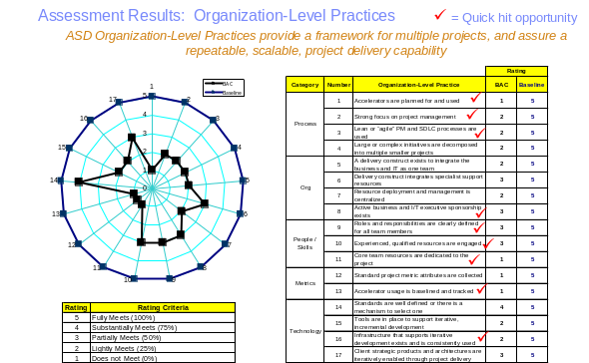
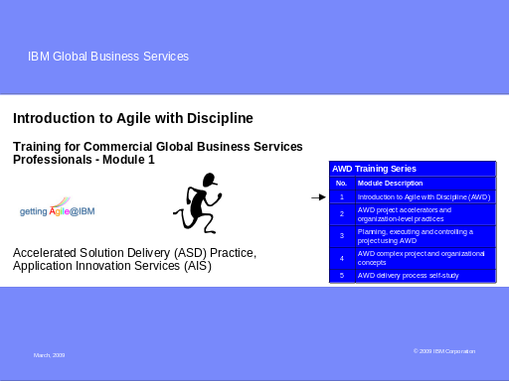
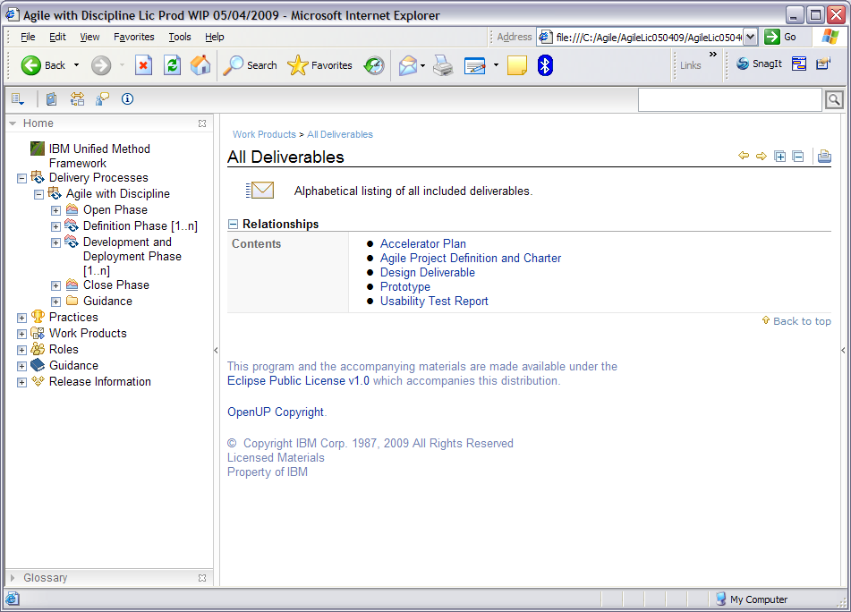
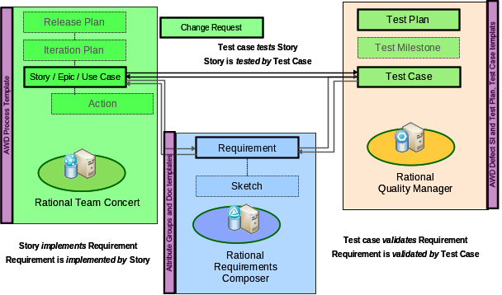
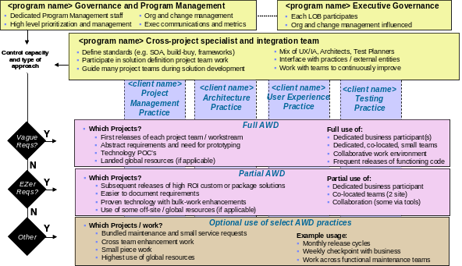
IBM’s “Agile With Discipline” (AWD) proven methodology and assets have accelerated projects for over 12 years
AWD Current State Practices Tool
AWD Training
AWD Delivery Process
AWD Rational Jazz Templates
Agile Governance Models

Slide 10
Agile With Discipline provides scalable agile practices that address other aspects that basic agile approaches fail to address
Lean program governance and management to drive short and long term success
Improve business / IT partnership (Align to business goals and priorities, improve visibility, flexibility, metrics)
Plan across projects (Release management, sourcing, teaming, locations, facilities, impacted entities, supporting infrastructure, risks, cost, time, budget, value)
Proactively support teams (Remove barriers, reduce phases and gates, broker continuous improvement)
Project / Organization
Lean support to drive & evolve technical standards that support agile
Refine technical standards (Define standard end-to-end practices, tooling, environments that support evolutionary design, evolutionary architecture, continuous integration and automated testing)
Proactively enable teams (Assist agile teams to adapt standards, participate, lay foundation for delivery, decouple backend systems, use reflections to improve technical support)
Accelerated definition practices
Identify requirements (Impacted entities, creative, business process models, epic stories & priorities)
Define technical solution (Breadth, architecture models, environments, reuse, prototype high risk)
Plan the project (Decompose into agile teams, limit cross-team dependencies, scope vs. time vs. cost)
Use JAR/JAD approach (Facilitated sessions, direct participation by business and I/T leads)
Key “Agile” development practices
Time-boxed development (Plan, build and verify in small chunks, reflect in short cycles)
Shared vision (Light charter, stories, flexible scope based on evolving requirements)
Whole team (Direct business participation, dedicated resources, creative collaboration)
Continuous integration and testing (Automated builds, early testing & validation)
Team

Slide 11




IBM’s disciplined, scalable agile delivery process is a four iteration governance approach to support agile delivery practices
OPEN
SOLUTION DEFINITION
SOLUTION DEVELOPMENT
CLOSE
OPEN (Inception)
Annual confirmation of scope and budget
One iteration per year
Product or project initiation activities
SOLUTION DEVELOPMENT (Construction or “Sprint” in Scrum)
Iteration planning every two to four weeks
Develop solution in small, chunks based on value and risk
Demonstrate and validate solution
Reflect on and tailor approach
Conduct final testing and launch at release increments
SOLUTION DEFINITION (Elaboration or “Sprint 0” in scrum)
One iteration to define agile teams and SME support
Define release cadence, number of agile teams, initial backlog
Lay foundation for agile teams
Subsequent iterations are conducted in parallel to solution development iterations
CLOSE (Transition)
Complete Project Control Book
Close all open items
Provides process improvements

Slide 12
Open Iteration – standard key activities and duration
OPEN
SOLUTION DEFINITION
OPEN
SOLUTION DEVELOPMENT
CLOSE
Update or write new charter
Refine vision, scope, stakeholders
Refine fixed capacity estimates
Submit request to executive stakeholders
Review with stakeholders
Secure approval to proceed
Receive approval to proceed
Refine agile team staff assumptions to match scope and funding
Communicate plans to all impacted stakeholders
Vision and initial funding
Idea
Hours
Days
(Longer based on LOB or Executive governance approach)
Hours
Notes:
Cover this quickly as it overviews material in Modules 4,5,6.

Slide 13
Solution Definition, or “Sprint 0” iterations should be standardized* and executed with repeatable activities and durations
OPEN
SOLUTION DEFINITION
SOLUTION
DEFINITION
SOLUTION DEVELOPMENT
CLOSE
Refine shared vision
Requirements envisioning (write or elaborate stories and storyboards)
Architecture envisioning (modeling)
Impact analysis
Consider feasibility / usability of solution
Release planning (x agile teams of y size with z skills, iteration timing)
Staff teams
Setup environment
Iteration planning
Initiate starter team (first iteration)
Plan envisioning sessions
Schedule stakeholders for envisioning sessions
Light-weight milestone review
Communicate vision to stakeholders
Commit to iteration and release cadence
Gut feel for work vs. time
Project / Product Approved to start
Stakeholder consensus
Up to a few hours
(If staff is on hand)
First iteration of a new product: Several weeks
Subsequent iterations: In parallel to Solution Dev
Up to a few hours
* Standardization should occur at the organization level, then tailored for each initiative based on specific leading work patterns related to the type of work being conducted
Notes:
The iteration rhythm is determined by the iteration length. Fixed iteration length helps drive the reliable rhythm of a project. Without this rhythm, you are constant revising, re-estimating, and reconciling ,
Cover this quickly as it overviews material in Module 7.

Slide 14
Solution Development, or “Sprint” iterations should also be standardized and executed with repeatable activities and durations
SOLUTION
DEVELOPMENT
OPEN
SOLUTION DEFINITION
SOLUTION
DEVELOPMENT
CLOSE
Iteration planning
Iteration modeling (Design or architecture)
Standard activities / practices:
Daily standup meeting / call
Story driven development
Evolutionary Architecture and Design – Add to models if useful
Architecture spike (task of a story)
Continuous Integration (automated at code check in, daily builds, keep build defect free)
Refactoring
Automated testing
Track “done” stories (e.g. burndown, working code is demonstrable)
Pair programming (for complex problems)
Product owner & SME’s may begin some pre-work for next iteration
Iteration demo
Retrospective
Consider sufficient functionality
Launch or pass to final test / launch
Iteration start (Wednesday best)
Potentially consumable solution
2 hours for each week of the iteration
Typical: Two weeks for simpler requirements
Four weeks for complex projects with cross-agile team integration
2 hours per each week of iteration
Notes:
The iteration rhythm is determined by the iteration length. Fixed iteration length helps drive the reliable rhythm of a project. Without this rhythm, you are constant revising, re-estimating, and reconciling ,
Cover this quickly as it overviews material in Module 7.

Slide 15
Close – standard key activities and duration
CLOSE
OPEN
SOLUTION DEFINITION
SOLUTION DEVELOPMENT
CLOSE
Iteration planning
Team survey / final reflection
Production readiness review
Deploy solution
Final transition planning
End-of-lifecycle testing and fixing
Pilot/beta the solution
Finalize documentation
Communicate deployment
Train/educate stakeholders
Defect tracking
Release resources (if ramping down)
Final report for period transitioning from
Final defect analysis
Customer satisfaction survey
Sufficient Functionality
Production Ready
Ideally: Hours
Ideally: Completed within solution definition iterations
Typical: 4 weeks
Days
Notes:
The iteration rhythm is determined by the iteration length. Fixed iteration length helps drive the reliable rhythm of a project. Without this rhythm, you are constant revising, re-estimating, and reconciling ,
Cover this quickly as it overviews material in Module 7.

Slide 16
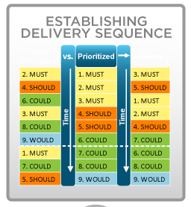
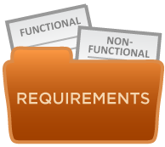

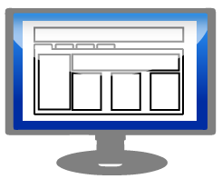



How teams iterate through a Solution Definition iteration
DEFINE REQUIREMENTS THROUGH STORIES, MAPS, STORYBOARDS, PRIORITIZE
ANALYZE FUNCTIONAL AND NON-FUNCTIONAL REQUIREMENTS
REVIEW AND REFINE GOALS, OBJECTIVES AND SCOPE
CHARTER
DESIGN ROUGH ARCHITECTURE / UI MODELS
Project Charter
Initial Backlog
INCREMENTALLY BUILD PLAN, BASELINE, AND GAIN APPROVAL / FUNDING
COMMUNICATE TO AND SECURE INVOLVEMENT FROM IMPACTED ENTITIES
PRODUCT ROADMAP
RELEASE PLAN
BRAINSTORM OPTIONS, DEVELOP ROUGH ESTIMATES OF EFFORT, SKILLS, IMPACT
SOLUTION DEFINITION: Key Work Products
Charter – Elaborates on vision, defines goals, objectives, business benefits
Agile Plan – Backlog, release plan (if applicable), iteration plans including prioritized requirements with descriptions (stories), estimates, timeboxes, planned accelerator usage
Design – Mind maps, high level architecture models , wireframes, glossy’s to elaborate on stories
High Level User Interface Prototype – Clickable wireframes and early usability evaluation

Slide 17
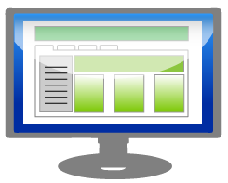



How teams iterate through a Solution Development iteration
WRITE TESTS AND WORKING CODE STORY BY STORY, COLLABORATE
BRAINSTORM DETAILED DESIGN, APPROACH AND ASSIGN WORK
ANALYZE BACKLOG AND SELECT STORIES
CREATE TEST PLANS, CASES, DATA, AND VERIFY STORIES
(Some may be done pre demo)
REFINE ITERATION PLANS / STORY WALLS
DEMONSTRATE CODE AND REFLECT
SOLUTION DEVELOPMENT: Key Work Products
Agile Plan – Track and manage variances to the baseline (majority within backlog)
Code and tests – Working code and tests that support the existing code base
Project Launch Package – Working application, Transition to Maintenance Plan, Test plans, cases, data, results, launch checklist

Slide 18

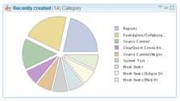
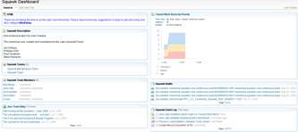
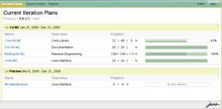
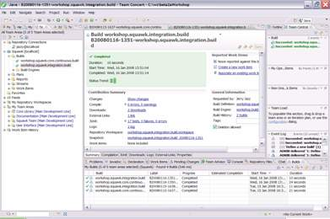
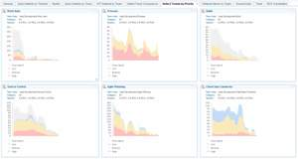
Our AWD template for Rational Team Concert (RTC) aligns with the end-to-end AWD process
RTC enables teams to work with little or no paper, and bridge communication challenges when the entire team cannot be co-located
Rational Team Concert
IBM Rational Team Concert - software innovation through collaboration
Supports out-of-the-box and custom defined process configuration, including AWD, which keep the team on a consistent, repeatable path to success
Provides an integrated team environment including integrated source control, work item, build and project management capabilities which "think and work" in unison
Enables real-time and offline "in-context" collaboration across distributed project teams
Provides real-time project health information and transparency of status through automated data gathering, Web dashboards, and metrics and reporting
Provides a broad choice of client environments including Eclipse, Visual Studio, Web Browser, command-line and integrates and extends the value of Rational ClearQuest® and ClearCase Enterprise Deployments as well as Subversion open source

Slide 19
Agenda
Agile Business Case and Transformation
IBM’s “Agile With Discipline” Methodology
Agile Processes and Teams
Agile Coaching
Agile Testing
Throughput Based Agile Estimation and Sourcing
Agile Implementation Experiences
Notes:
IBM Confidential

Slide 20



The Agile Development Center Process Model defines interfaces between the client, the on-site team, and the off-site team
Solution Requirements
Client Development Center
IBM Agile Development Center (on-site)
Requirements Elaboration and
De-Comp
IBM Factory (off-site)
Work item review with On-Shore analyst and Off-Shore Dev & Test
Create unit
test
Code (Reuse, Pairing, daily, check-in)
Unit Test
Business Case
Project Charter
Prioritized Backlog of Epic/User Stories or Use Cases w/ Acceptance Criteria & NFRs (RTC)
Quality review for Work Item with On-Shore Analyst and Off-Shore Dev & Test
Clear test cases & data
Execute test cases
Review & Prioritization of backlog
Iteration Planning
Product Owner Feedback
Iterative Development
Iteration Demo
Standards & Guidelines
RTC Dashboard of Work Item, Iteration, and Release progress and status
Continuous Integration Environment with current executable app
Release integration, Testing, Deployment
Audio, Video, Collaboration tools
Enabling Technologies and Tools
Notes:
IBM Confidential

Slide 21
A continuous flow of information exists between the on-site and off-site teams to drive round-the-clock execution
US Evening
“Day in the Life”
India Morning
Consider Near-Shoring for Higher Overlap
Begin or continue design / develop / test
New / updated requirements
Clarifications
Document simple clarifications required from US
Process and tooling
Verify that work completed by India meets needs
Team has one daily call per day to touch base and ask questions
Submit completed functionality for verification
Requirements and Design work
Discuss India questions and new functions
Discuss progress, updates / questions
US Morning
India Evening

Slide 22
The Development Center will be staffed using a team-based model that can be scaled up based on the required capacity
Phase 1
Landed
Off-shore
Development Center
Management Team
Dev Center Manager
Dev Center Administrator
Methods and Metrics Specialist
Technical Infrastructure Specialist
Agile Coach
Team 1
Development Center
Management Team
Agile Coach
Dev Center Manager
Dev Center Administrator
Methods and Metrics Specialist
Technical Infrastructure Specialist
Team 2
SR
SR
Phase 2
Team 3
SR
SR
Team 4
Project Support Team
Cell Manager
Data Modeler
Code Quality Specialist
Quality Analyst
Database Administrator
Project Support Team
Compliance Analyst
Software Engineer
Graphic Designer
SR
SR
Team Lead
Analyst
Developer
Tester
Leads are Bold
SR = Senior Resource
Notes:
IBM Confidential

Slide 23
Agenda
Agile Business Case and Transformation
IBM’s “Agile With Discipline” Methodology
Agile Processes and Teams
Agile Coaching
Agile Testing
Throughput Based Agile Estimation and Sourcing
Agile Implementation Experiences
Notes:
IBM Confidential

Slide 24
IBM Agile Coaching Services guide new client agile teams in adopting and using agile practices to ensure a strong and successful start
The Agile Coach will…
Assess suitability, readiness, and implementation requirements for agile practices
Tailor agile practices and implementation plan to client, role, and personal requirements
Guide agile practice implementation
Actively coach agile team members as each agile practice is initially implemented
Facilitate continuous improvement discussions and actions
Transition the agile practice implementation and improvement plan to client team
Report out on coaching achievements and recommended improvement areas and actions

Slide 25
The agile coaching process typically consists of three phases, beginning with an installation of the basic agile practices
Phase 1
Quick Startup
or
Transformation
Results
Phase 2 - Hands On Coaching Phase
Phase 3
Arms-Length
Coaching
& Guidance
Standard Work
and Competency
Assessments and
Line Startup
Assessment
With Results
Actions for
continued
improvement
Collocation
Iteration Cadence
Stand-ups
“2 week” cards
Assessments & Gap Analysis
Coaching activities based on Assessment gaps
Final Standard Work/Competency Assessment to determine progress/ achievements
Teams take lead on self improvement plans based on roadmaps
Specific, “on demand” coaching and training
Periodic Standard Work Assessments to measure progress
~2 months
~2 months
~4-6 months

Slide 26
Agile coaching employs several methodologies, including Mentoring, Coaching, and Paired Performing
A “Teaching Hospital” model is utilized consisting of 10% formal training, 20% mentoring, and 70% OJT
Coaching a new team often involves aspects of Teaching, Mentoring, and Coaching, depending on the maturity of the coachee; therefore we incorporate each of these in our coaching
“Chalk Talk” sessions are utilized throughout the coaching period as a vehicle to deliver teaching and review team decisions
One-on-one coaching is done by the coaches with practitioners in their respective areas
Weekly group coaching “check-ins” are held with coaches and all the coachees in a role, to monitor and take the pulse on how coaching is going
Coaches are aware of other agile teams’ practices, through Community of Practice meetings, and shared appropriately with the teams being coached

Slide 27
Coaching activities are based on implementing the adopted agile practices, including team education and mentoring in key disciplines
Coaching Activity | Iteration Management | Analysis | Development | Testing
Agile One Day Workshop | X |  | X
RTC Training Session | X | X | X | X
Story Writing and Requirements Workshop | X | X
Industry best practice sessions on design, coding, development architecture. |  |  | X
Pair programming, White boarding, Unit test writing, Continuous Integration strategy, tools, and setup training |  |  | X | X
Acceptance Criteria using Gherkin training for Acceptance Test Driven Development |  | X |  | X
Tasking Presentation |  |  | X
Test Strategy and Test Configuration Management |  |  |  | X
TDD Concepts Presentation and Workshop |  |  | X
Tools consolidation, standardization and training: RTC, QC, Gherkin, Cucumber, Eclipse, Ruby, Hudson, Code analysis using SONAR (Cobertura, Gmerics, CodeNarc), build scripts (ANT, Maven), and deploy script (Jython, Jacl). |  |  | X | X
Agile Overview sessions for new team members (multiple sessions) |  | X | X | X

Slide 28
IBM’s coaching helped this client achieve their objectives for moving to agile development
Client Objectives
Results
Reduce Cycle Time while maintaining productivity
Size and estimate requests more accurately and increase delivery schedule predictability
Increase transparency into the progress and status of requests
Increase quality of code and product being implemented
Increase scalability (up and down) to meet capacity needs to service requests
Reduce dependency and reliance on critical SMEs needed to perform requirements and design analysis
Coach the team in writing requirements using business language rather than design language
Coach the team in TDD processes and tooling (Cucumber, Gherkin, Ruby)
Clients and product owners remarked that cycle time had decreased
After the coaching period, team was delivering most of their stories in the 2-week iteration
Product owners attended Show & Tells and visited the team room
Increase quality of code and product being implemented
Client decided to add 3 additional agile teams to their business area based on results
Developers became more active in analysis and design due to agile collaboration
User stories were written in standard “As a <role> I want <feature> so that <business value>”
Team acquired training and began automation of some test scripts

Slide 29
Key IBM Agile Coaching Differentiators
Resources will be tightly linked with other Agile initiatives
  e.g., GOTD Agile Testing using Test Data Management and Interface Virtualization technologies
  Leadership resources will be leveraged across initiatives
Resources will have software engineering skills and will help drive Application Architecture, Design Modeling, and Tool Usage best practices
Resources are experienced in RUP and can easily learn USDM with Agile Practices
IBM’s Agile With Discipline methodology encompasses existing Agile Practices
IBM has experience in scaling Agile development to very large global teams to support IBM internal software development, as well as external customers

Slide 30
Agenda
Agile Business Case and Transformation
IBM’s “Agile With Discipline” Methodology
Agile Processes and Teams
Agile Coaching
Agile Testing
Throughput Based Agile Estimation and Sourcing
Agile Implementation Experiences
Notes:
IBM Confidential

Slide 31



























What is driving the need for improved Testing Practices?
Increasing
Cost of Quality
Increasing
Development Complexity
Balancing
Quality and Speed
Public Cloud
Private Cloud
Traditional
Testing
Routing
Service
Web/
Internet
Content
Providers
EJB
Business Partners
Collaboration
Testing costs
Third-party
Services
Archives
Shared
Services
Portals
Messaging Services
File systems
Directory Identity
Other costs
Data Warehouse
Mainframe
Enterprise Service Bus
Heterogeneous Environments
13%
The forecasted increase
in wages for India IT
workforce in 2011ª
$5-30 million
The typical investment to build
a single test lab for a Fortune 500 company. Most have dozens ^{b}…
30-50%
The average amount of time
testing teams spend on setting up test environments, instead
of testing ^{c}
* Source:http://www.sei.cmu.edu/about/message/

Slide 32
Traditional vs. Agile Testing
Agile Testing
The entire team is responsible for delivering a quality application
  Not a separate activity that only “testers” do
  Test activities are part of work plan for team
Testing is an integrated activity on an agile team
Testing activities are shared by entire team including:
  Creating, executing and building automated acceptance test
  Clarify stories, flush out hidden assumptions
  Help the team automate tests
  Make sure the acceptance tests verify the quality specified by the customer
Form an integral part of the continuous feedback loop that keeps the team on track
Traditional Testing
Only the Test team is responsibility for delivering a quality application.
Traditional test team is comprised of
  Quality Manager
  Test Lead
  Tester
Most of the testing activities start toward the end development
Notes:
Team Change Management Workshop
Workshop Introduction

Slide 33

Continuous Integration Process
3
5
6
Developer
Private Build
Integration Build
QA Build
Extract source
Integration Build
1
Extract source
Extract source
Accept New Work Item
Compile / package
Compile
Compile
Automated testing
Package
Package
2
Analysis
Automated testing
Test
Code
Automated testing
Manually initiated
Analysis
Analysis
Automated deploy
Automated deploy
Automated testing
Automated testing
Publish results
Publish results
4
Notify team
Notify team
7
Check-in
Automatically initiated
On-demand / Scheduled
8
Metrics
Continuous Integration automates and improves software integration and validation, providing early problem detection and delivery of higher quality code

Slide 34
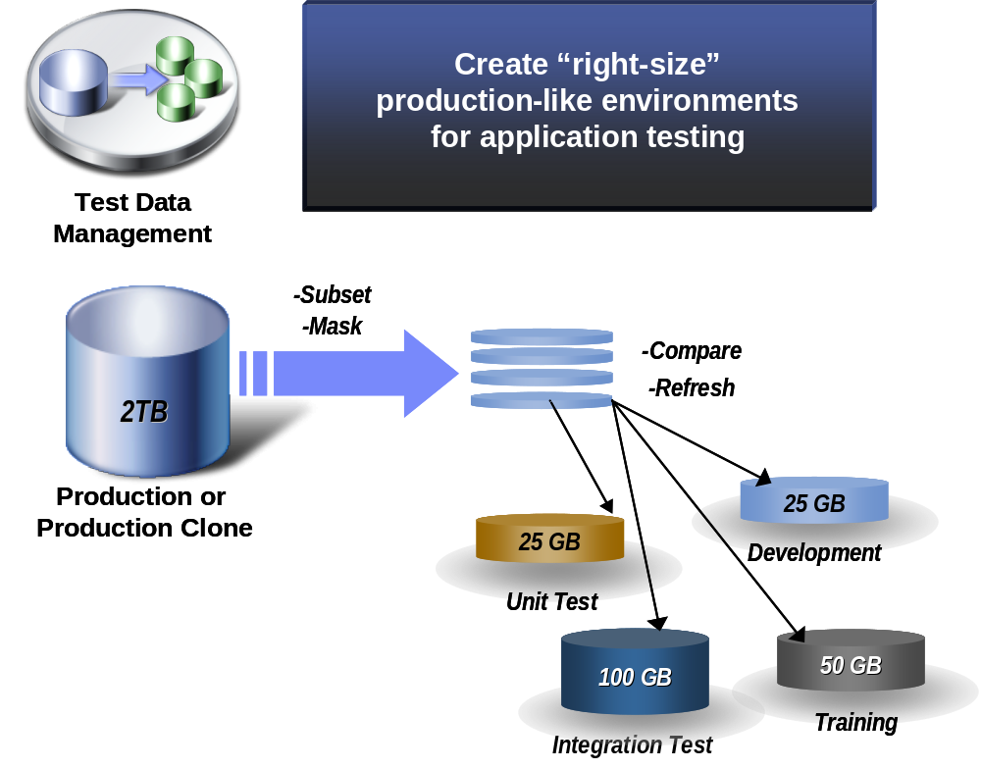
Test Data Management
Utilize a Test Data Management (TDM) tool to:
Create multiple instances of referentially intact, “right-sized” test databases
Automate test result comparisons
Support test data customization
Anonymize test data
Test Data Management tools:
Reduce time to create test data
Reduce storage requirements by utilizing subsets of data
Facilitate parallel development and testing
Notes:
IBM Confidential

Slide 35
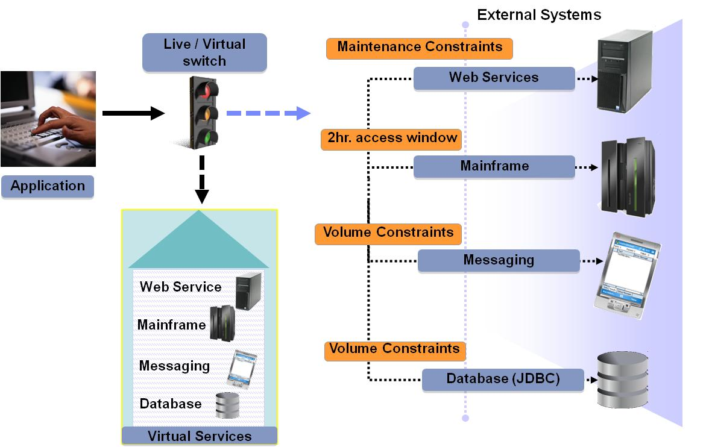
Application Virtualization / Mock Objects
Utilize Application Virtualization to simulate services / interfaces that are unavailable, non-performant, or that return undesirable results
Use mock objects to facilitate unit and functional testing
Application Virtualization captures the behavior and characteristics of back-end systems to simulate test environments
Notes:
IBM Confidential
Full diagram on Slide 32.

Slide 36
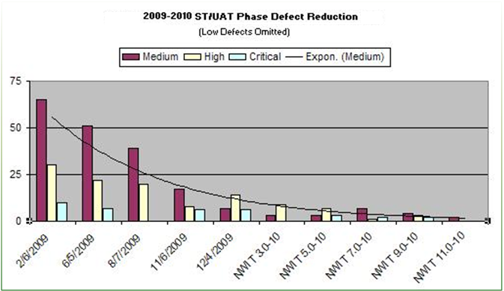





Success Achieved from Agile Testing
IT & Business
Co-located
Introduced QTP Automation
Adopted Paired Programming
Adopted TDD
Adopted ATDD
IBM-Client team produced zero-defect releases for more than 80% of the time while interfacing with 32 supporting applications
Accelerated time to market – concept to cash
Reduced production support cost by 25%
Innovative use of pair programming for skill uplift of testers

Slide 37
Agenda
Agile Business Case and Transformation
IBM’s “Agile With Discipline” Methodology
Agile Processes and Teams
Agile Coaching
Agile Testing
Throughput Based Agile Estimation and Sourcing
Agile Implementation Experiences
Notes:
IBM Confidential

Slide 38



Throughput Based Agile Services Model
Work Item Sizing
Client review & Feedback/Acceptance and Prioritization
Work Item Request
Work Item with Size
and required Client SME Input
ClientSME(s)
(if needed)
Work Item is added to team’s prioritized Backlog Production Schedule (If Accepted)
Concise Sizing
Definitions
(XS,S,M,L,XL)
IBM Team Lead
IBM Analyst
IBM Tech/Dev Lead
IBM Test Lead
Iteration n
Iteration n
Iteration n+1
Iteration n+2
Iteration n+2
Iteration n+2
Iteration n+3
Iteration n+..
Iteration n+..
Iteration n+..
IBM Agile Team/Line
Fixed/Dedicated
Capacity & Capability*
Pricing Table Example
Size Units Hours
X-Small 1 8
Small 2 16
Med 3 24
Large 5 40
X-Large 8 64
Client review & Feedback/Acceptance based on Demo & Client Testing
Completed Work Items
SMEs
IBM
Client
*Capacity and Capabilities reviewed and adjusted quarterly

Slide 39
Throughput Model Features
Contract is based on purchased development throughput over a specified period of time (units per month/year) and unit price
Contracted Throughput is reviewed quarterly and adjusted to client needs and agreement (increase or decrease requires 30 days from review/agreement)
Work Item unit sizing is based on concise descriptions and examples for each technology (Java, COBOL, SAP, etc.) Client can request a review of a sized work item by a Client/IBM review board if size is questioned.
Change Board reviews appeals which may arise later in the delivery process if major requirements or design changes are needed by Client or Supplier
New work items are slotted by client into the backlog of other backlog items based on client’s priority. Production schedule is adjusted accordingly (pushing out lower prioritized items in the schedule)
Progress to the production schedule is reviewed and adjusted at the end of each Iteration (2 weeks)
Work is performed to defined Standards (architecture, coding, testing, etc.) and is verified by client in the acceptance process

Slide 40
Throughput Model Planning and Scheduling
Schedule
Iteration n
Iteration n
2 Weeks
Iteration n+1
2 Weeks
Iteration n+2
2 Weeks
Iteration n+3
2 Weeks
Iteration n+….
2 Weeks
Throughput
X Units
X Units
X Units
X Units
X Units
Work Item 1 (S - x units)
Work Item 2 (S- x units)
Work Item 3 (L – x units)
Work Item 4 (M – x units)
Work Item 5 (S – x units)
Total = X Units
Work Item 6 (M - x units)
Work Item 7 (L- x units)
Work Item 8 (L – x units)
Work Item 9 (M – x units)
Total = X Units
Work Item 10 (S - x units)
Work Item 11 (L- x units)
Work Item 12 (L – x units)
Work Item 13 (M – x units)
Work Item 14 (S – x units)
Total = X Units
Work Item 15 (XL - x units)
Work Item 16 (L - x units)
Work Item 17 (L – x units)
Total = X Units
Work Item 18 (S - x units)
Work Item 19 (S- x units)
Work Item 20 (M – x units)
Work Item 21 (M – x units)
Work Item 22 (S – x units)
Work Item 23 (S – x units)
Work Item 24 (S – x units)
Total = X Units
Prioritized Work Queue
Iteration periods are 2 week fixed duration, with a recurring planning and review cadence
Iterations have fixed throughput capacity, which is reviewed quarterly and can be adjusted to Client’s required demand level, per unit price remains unchanged
Incoming work items are prioritized into the existing prioritized production iteration plan. Lower priority work items in the plan are bumped into future iterations
Progress-to-schedule is reviewed with client at the end of each iteration to ensure schedule is adjusted when necessary based on production results

Slide 41
Agenda
Agile Business Case and Transformation
IBM’s “Agile With Discipline” Methodology
Agile Processes and Teams
Agile Coaching
Agile Testing
Throughput Based Agile Estimation and Sourcing
Agile Implementation Experiences
Notes:
IBM Confidential

Slide 42









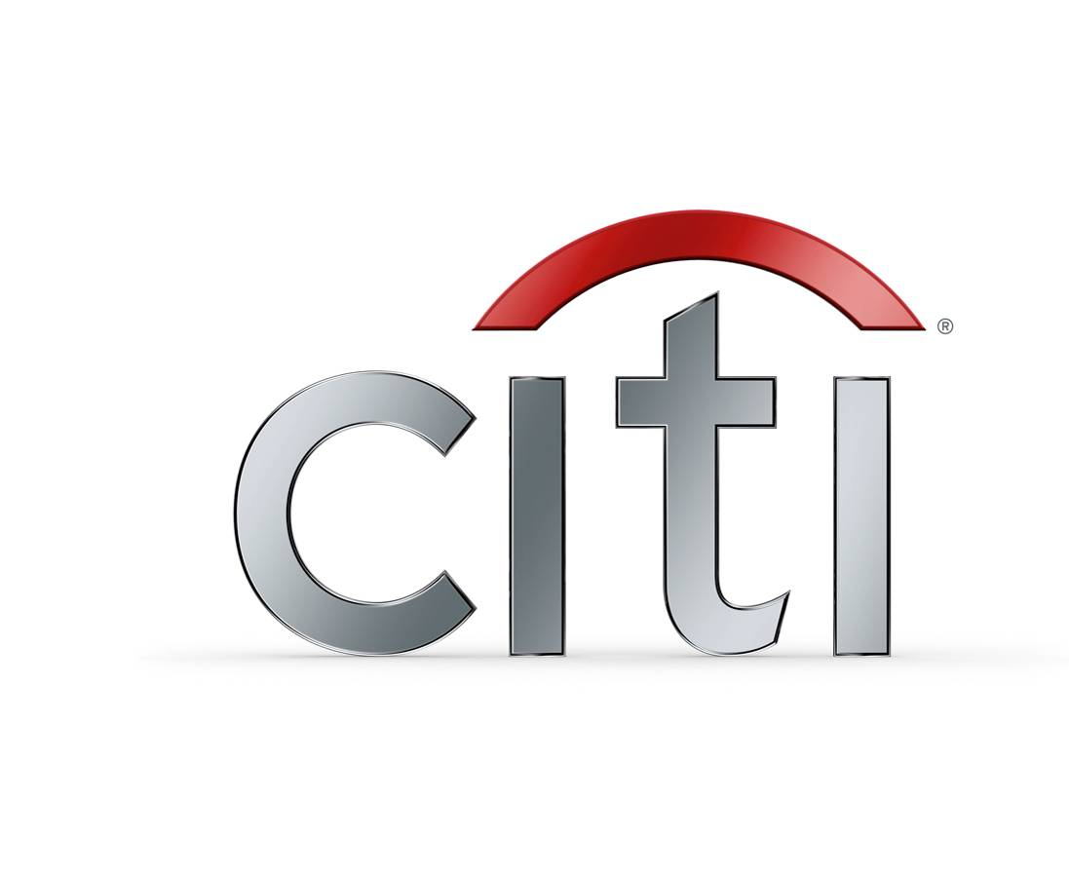











IBM has been implementing agile services for over twelve years and tailoring engagements to meet specific client wants and needs
Individual project delivery
Current state assessment and planning
Agile Optimization (including some partnering with Rational)
State of VA
State of WA
Notes:
IBM Confidential

Slide 43
Large U.S. Insurance Company - Turnkey project delivery and leadership in establishing and running a client development center
The Solution
The Challenge
Quickly ramp up an agile development center
Assist a major U.S. Insurance Company in establishing an agile based Application Development Center (ADC)
Demonstrate the value of the model to allow rapid expansion of the center
Expand agile development capacity with additional qualified teams
Lead the coaching effort to rapidly spread the model to other ADC teams, business areas, and geographies
Establish initial IBM team reporting to Client’s Application Development Center Manager and quickly begin agile based delivery
Staff the teams with experienced and trained agile PM, BAs, Testers and Developers
Staff thought leaders and experienced practitioners as coaches to assist ADC teams in standardized process adoption.
Perform leadership roles to demonstrate, mentor, and coach client’s team members in agile practices and ADC processes
Use Rational Team Concert for iteration planning, tracking, backlog management and burn-down reporting
Use Rational Asset Manager for asset reuse
Results/Accomplishments
Initial team delivered multiple, major releases of mission critical call center applications on time, on budget, with required scope and with many zero defect releases.
IBM staff successfully facilitated contention between multiple client business, program, and I/T stakeholders
Used landed IBM global delivery resources and are planning for offshore agile project delivery capabilities
Our teams were used in achieving CMMI level 3 for the development center
Provided additional thought leadership to development center leadership that resulted in the implementation of additional center level standards, including the implementation of common agile tooling
Led the expansion of the agile based practices to other business and geographical areas in Columbus, Des Moines, and Scottsdale

Slide 44
Case study: Distributed Agile in product development for a network equipment major in Europe
Business Challenges
Shorter time to market
Frequent change in requirement priorities
Multi-site distributed Agile development
Quality deliverable at frequent intervals
IBM Approach
Client Benefits Realized
Agile Methodology – Scrum + Extreme Programming
Iteration of two weeks
Initial sprints dedicated for development, test, continuous integration environment setup
Communication tools such as Webex, Messaging tool, telecom, Wiki
Client SME on rotation basis at offshore location
Agile coach
Feature drops at intervals of two weeks
Tested product at every sprint
Multiple team collaboratively developing features
Accommodation for change in priorities at short intervals
Continuous improvement by scrum teams
Frequent feedback to development team
Scaled from 35 to 150 members
Project running from last 3+ years
Why IBM?
Experience in distributed Agile
Skilled resources with knowledge of technology and domain
Able to ramp up and ramp down based on needs

Slide 45
Metrics from IBM Rational’s Agile transformation
Metric | Goal | 2006 Measurement | 2011 Measurement
Maintenance / Innovation | 50/50 | 42% / 58% | 31% / 69%
Customer Touches / Product | 100 | ~10 | ~ 400
Customer Calls | -5% YoY | ~ 135,000 | ~100,000 (-19% since 2009)
Customer Defect Arrivals | -5% YoY | ~ 6,900 | ~2200
On Time Delivery | 65% | 47% | 94%
Defect Backlog | 3 Months | 9+ Months | 3 months
Enhancements Triaged | 85% | 3% | 100%
Enhancements into Release | 15% | 1% | 21%
Customer Sat Index | 88% | 83% | 88%
Beta Defects Fixed Before GA | 50% | 3% | 95%
Cost of Poor Quality |  | ~ $10,000,000 | ~ $5,600,000

Slide 46
IBM’s lessons learned help accelerate agile adoption
Remove organizational barriers between business and IT
While agile practices are (fairly) easily for an agile team to adapt, integrating the model with the enterprise is challenging.
Focus must be on the mission, less on model purity and perfection (apply the “just good enough” lean principles)
An Agile Development Center is a “Center of Excellence” opportunity
Invest in showcasing the Center to attract interest and work
Don’t let the new model take the blame
Perception of higher costs – the value of time-to-benefit (and opportunity costs) must also be included in analysis
Loss of control and credit for success – minimize through transparency
Notes:
IBM Confidential

